Slide 1

What are the Dutch municipalities that have an average household income above EUR 40000?
CoTaPP: Computational Thinking and
Programming with Python
All icons by: https://www.flaticon.com/

Slide 2
Lecture 9:
File I/O and
Error Handling
CoTaPP: Computational Thinking and
Programming with Python
All icons by: https://www.flaticon.com/

Slide 3

Previous lecture
Data structures
  lists
  tuples
  dictionaries
  sets

Slide 4
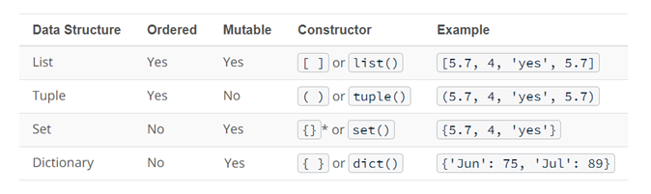
Previous lecture

Slide 5


Today’s lecture

Slide 6
Today’s lecture
string
int

Slide 7
Today’s lecture
string
int
for
while

Slide 8
Today’s lecture
string
int
for
data structures
while
functions
functions

Slide 9

Today’s lecture
string
int
for
data structures
while
functions
functions

Slide 10

Today’s lecture
string
int
for
data structures
while
functions
functions

Slide 11

Today’s lecture
string
int
for
data structures
while
functions
functions

Slide 12
Today’s lecture
DATA
INFORMATION

Slide 13
What are the Dutch municipalities that have an average household income above EUR 40000?
CoTaPP: Computational Thinking and
Programming with Python
All icons by: https://www.flaticon.com/
Notes:
Take ideas and write them down
If they mention ChatGPT, show them my attempts and these notes:
Problems with ChatGPT:
- format
- froze
- refused to give answer
- adapted question means making the query again

Slide 14
Today’s lecture
Reading and Writing Files
CSV Files
Error Handling
Notes:
At this point, stop the presentation, open the dataset file, and pose the question again: What are the Dutch municipalities that have an average household income above EUR 40000?
What are the challenges now?

Slide 15

File Input/Output (I/O)
Notes:
At this point, stop the presentation, open the dataset file, and pose the question again: What are the Dutch municipalities that have an average household income above EUR 40000?
What are the challenges now?

Slide 16
Next lecture
Notes:
Now we have learned how to open and close files, and read and write from them. We have also learned some operations we can perform with csv and pandas. And we have learned how we can catch errors and process them instead of letting the program fail.
But what do we do with those errors?
How can we create better visualizations of the data?
How can we do some mathematical analysis of the data?

Slide 17
Next lecture
CRISP-DM
  Reference model for approaching data analysis problems
Python libraries for data science
  Pandas, NumPy and Matplotlib

Slide 18
To Do
Exercises for the week
  Use Quarterfall to submit them
    Quarterfall problems? Contact your seminar assistant, and read the help section of Quarterfall
    Problems persist? Contact Isaac or me.
Notes:
Quarterfall problems? Contact your seminar assistant, and read the help section of Quarterfall. Problems persist? Contact Isaac or me.

Slide 19
To Do
Exercises for the week
  Use Quarterfall to submit them
Work on Project 2
  Project group problems? Contact us soon
Notes:
If you get stuck, or if you have a problem with your group, or any other inconvenience, get in touch with your seminar assistant as soon as possible. Do not wait until after the deadline to complain about missing partners.

Slide 20
To Do
Exercises for the week
  Use Quarterfall to submit them
Work on Project 2
  Project group problems? Contact us soon
  Missed deadline?
    Until midnight on 15/3 → 1 point deduction
    On or after 16/3 → not accepted
Notes:
If you get stuck, or if you have a problem with your group, or any other inconvenience, get in touch with your seminar assistant as soon as possible. Do not wait until after the deadline to complain about missing partners.

Slide 21
To Do
Exercises for the week
  Use Quarterfall to submit them
Work on Project 2
Practice practice practice!
  StudyLens

Slide 22
To Do
Exercises for the week
  Use Quarterfall to submit them
Work on Project 2
Practice practice practice!
Ask questions!
  Lecture
  Seminar
  Q&A sessions
  Office hours

Slide 23
To Do
Exercises for the week
  Use Quarterfall to submit them
Work on Project 2
Practice practice practice!
Ask questions!

